Slide 1
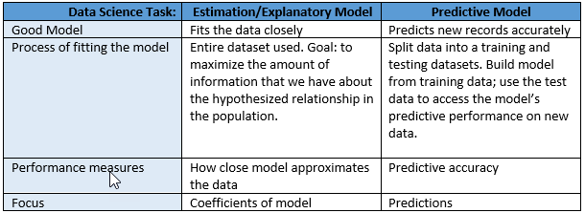
Chapter 8: Simple Linear Regression
Two variables:
Input or explanatory variable
Response or target variable (continuous quantitative)

Slide 2



Example: Cereal Dataset (excerpt)

Slide 3
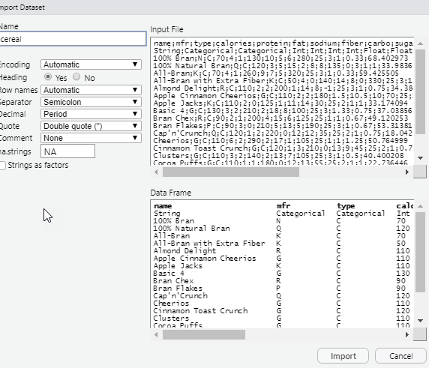
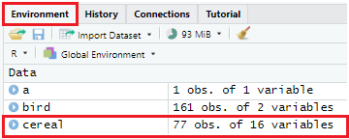
First import dataset:
Import cereal dataset:
Set your working directory.
Environment>Import Dataset>From Text (base). . .
Select dataset cereal
Click Import button

Slide 4
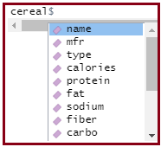



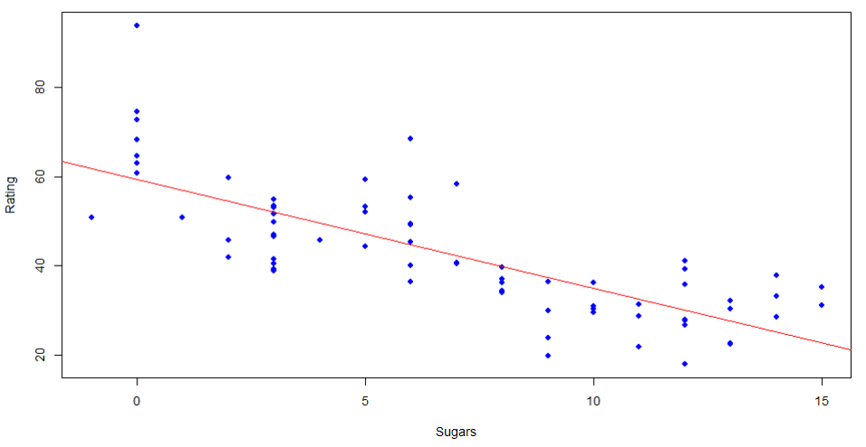


Scatterplot of rating vs. sugars with least-squares regression line
Population equation:
Least-squares line equation:

Slide 5
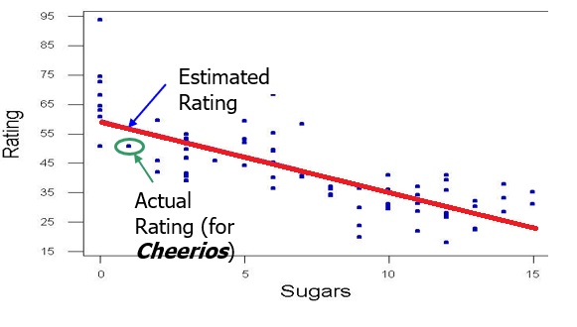


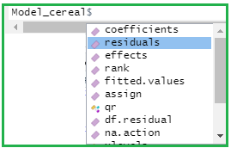



Estimate the rating for cereal with sugars = 1 gram.

Slide 6
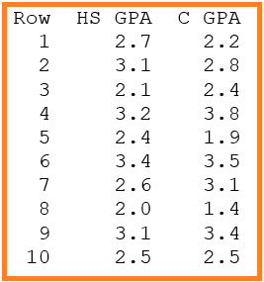


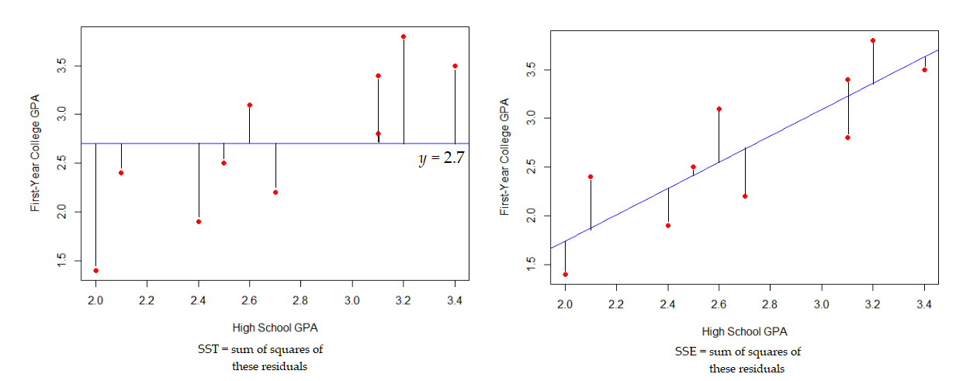

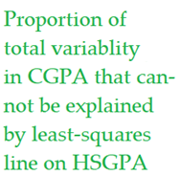

Coefficient of Determination, r²

Slide 7
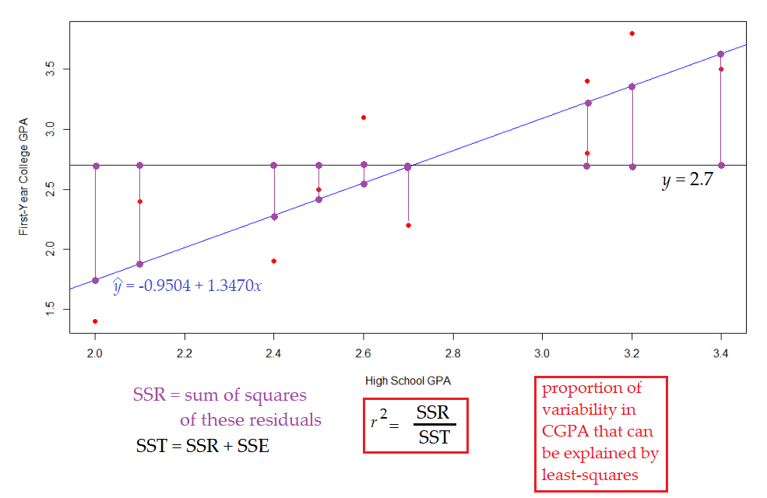

Slide 8


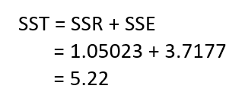



anova commands

Slide 9
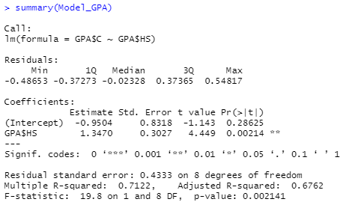
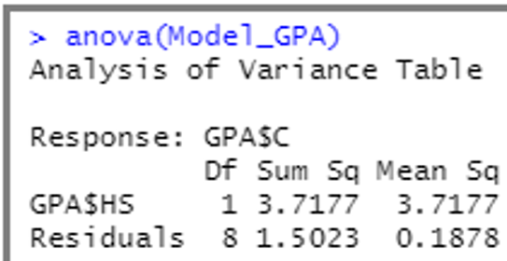
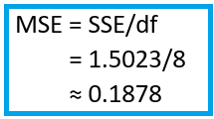
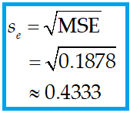
Summary command

